Slide 1
Evaluating the Efficiency and Effectiveness of Naïve Bayes for Spam Detection
A Comparison With Other Machine Learning Algorithms
Earl John Gallarde
ML1 Final Project

Slide 2
What is the Naïve Bayes Algorithm?
A probabilistic machine learning model used for classification tasks, which applies Bayes' theorem with the "naive" assumption of independence between every pair of features.
Naive Bayes calculates the probability of a class given a set of features (P(Class | Features)). It then predicts the class with the highest probability for a given instance.
Naive Bayes classifiers have shown remarkable performance, especially in text classification tasks such as spam detection, document categorization, and sentiment analysis.

Slide 3
Types of Naïve Bayes Classifiers
01
02
03
04
Multinomial Naïve Bayes
Gaussian Naïve Bayes
Particularly effective for text classification tasks where features are the frequencies of words or n-grams in documents
Best suited for datasets with continuous features and is often used in classification tasks where feature values are expected to be normally distributed.
Bernoulli Naïve Bayes
Complement Naïve Bayes
Suitable for datasets where features are binary, such as text classification tasks where the interest is whether a word appears in the document or not
Designed to address the imbalance in datasets by using the complement of each class to compute weights. It's an adaptation of the Multinomial Naive Bayes for imbalanced data.

Slide 4
Advantages of Naïve Bayes
Independence Assumption
Assumes all features in the dataset are independent of each other given the class label. This means that the presence or absence of a particular feature is considered to not affect the presence or absence of any other feature.
Interpretability
Training & Prediction Speed
Easy to understand, especially compared to more complex models like SVM or GBM
Significantly faster than many other algorithms, especially on large datasets

Slide 5
Advantages of Naïve Bayes
High-Dimensional Data
Scalability
Performs exceptionally well with
high-dimensional data
Suitable for applications with a large number of features, such as text classification
No Requirement for Feature Scaling
Unlike models such as SVM and Logistic Regression, it does not require feature scaling to perform well

Slide 6
Contexts Favoring Naïve Bayes
Text and Categorical Data (High-dimensional)
Real-time Prediction: The simplicity of Naive Bayes allows for quick updates to the model as new data arrives
Baseline Modeling: Serves as an excellent baseline. It can quickly provide a performance benchmark for a classification task, against which more complex models can be compared.

Slide 7
Limitations and Considerations
Independence Assumption
Feature Correlation
Assumes all features are independent of each other
Can lead to less accurate predictions, as Naive Bayes fails to capture the interactions between features.
Handling Continuous Data
Model Complexity and Flexibility
Requires discretization of continuous features (converting to discrete categories or bins), which can introduce bias or loss of information
Compared to more complex models, it has fewer parameters and less flexibility to capture complex patterns in the data, potentially leading to underfitting

Slide 8
Ultimate Spam/Ham (Compilation)
About the Dataset:
Taken from Kaggle
51,265 datapoints
3 columns
Index
Email Message Body
Label (Spam or Ham)

Slide 9
# Assuming a TF-IDF train-test data is available # Import from sklearn.naive_bayes import MultinomialNB # Initialize and train the Multinomial Naive Bayes model model = MultinomialNB() model.fit(X_train_tfidf, y_train)
Implementing Naïve Bayes

Slide 10
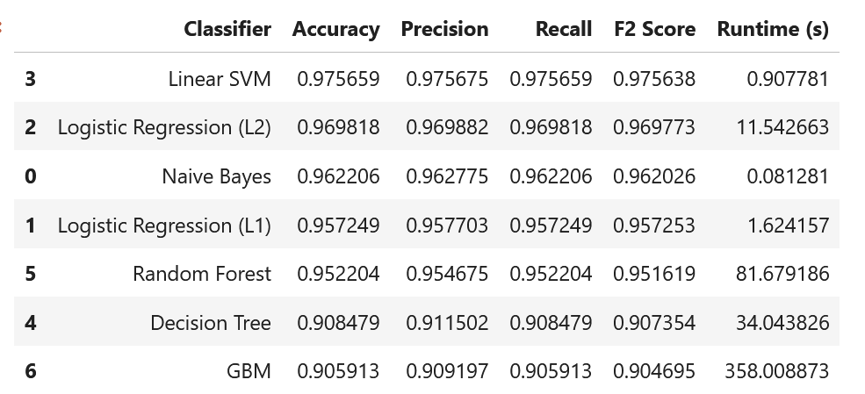
Comparing Naïve Bayes with Other Classifiers
Notes:
No consigo hacer update in theme, no se que me pasa con esta slide en todas las present :S

Slide 11
Conclusion
Naïve Bayes provides an excellent balance, offering respectable accuracy with minimal computational cost, ideal for applications needing rapid responses or dealing with vast datasets.

Slide 12
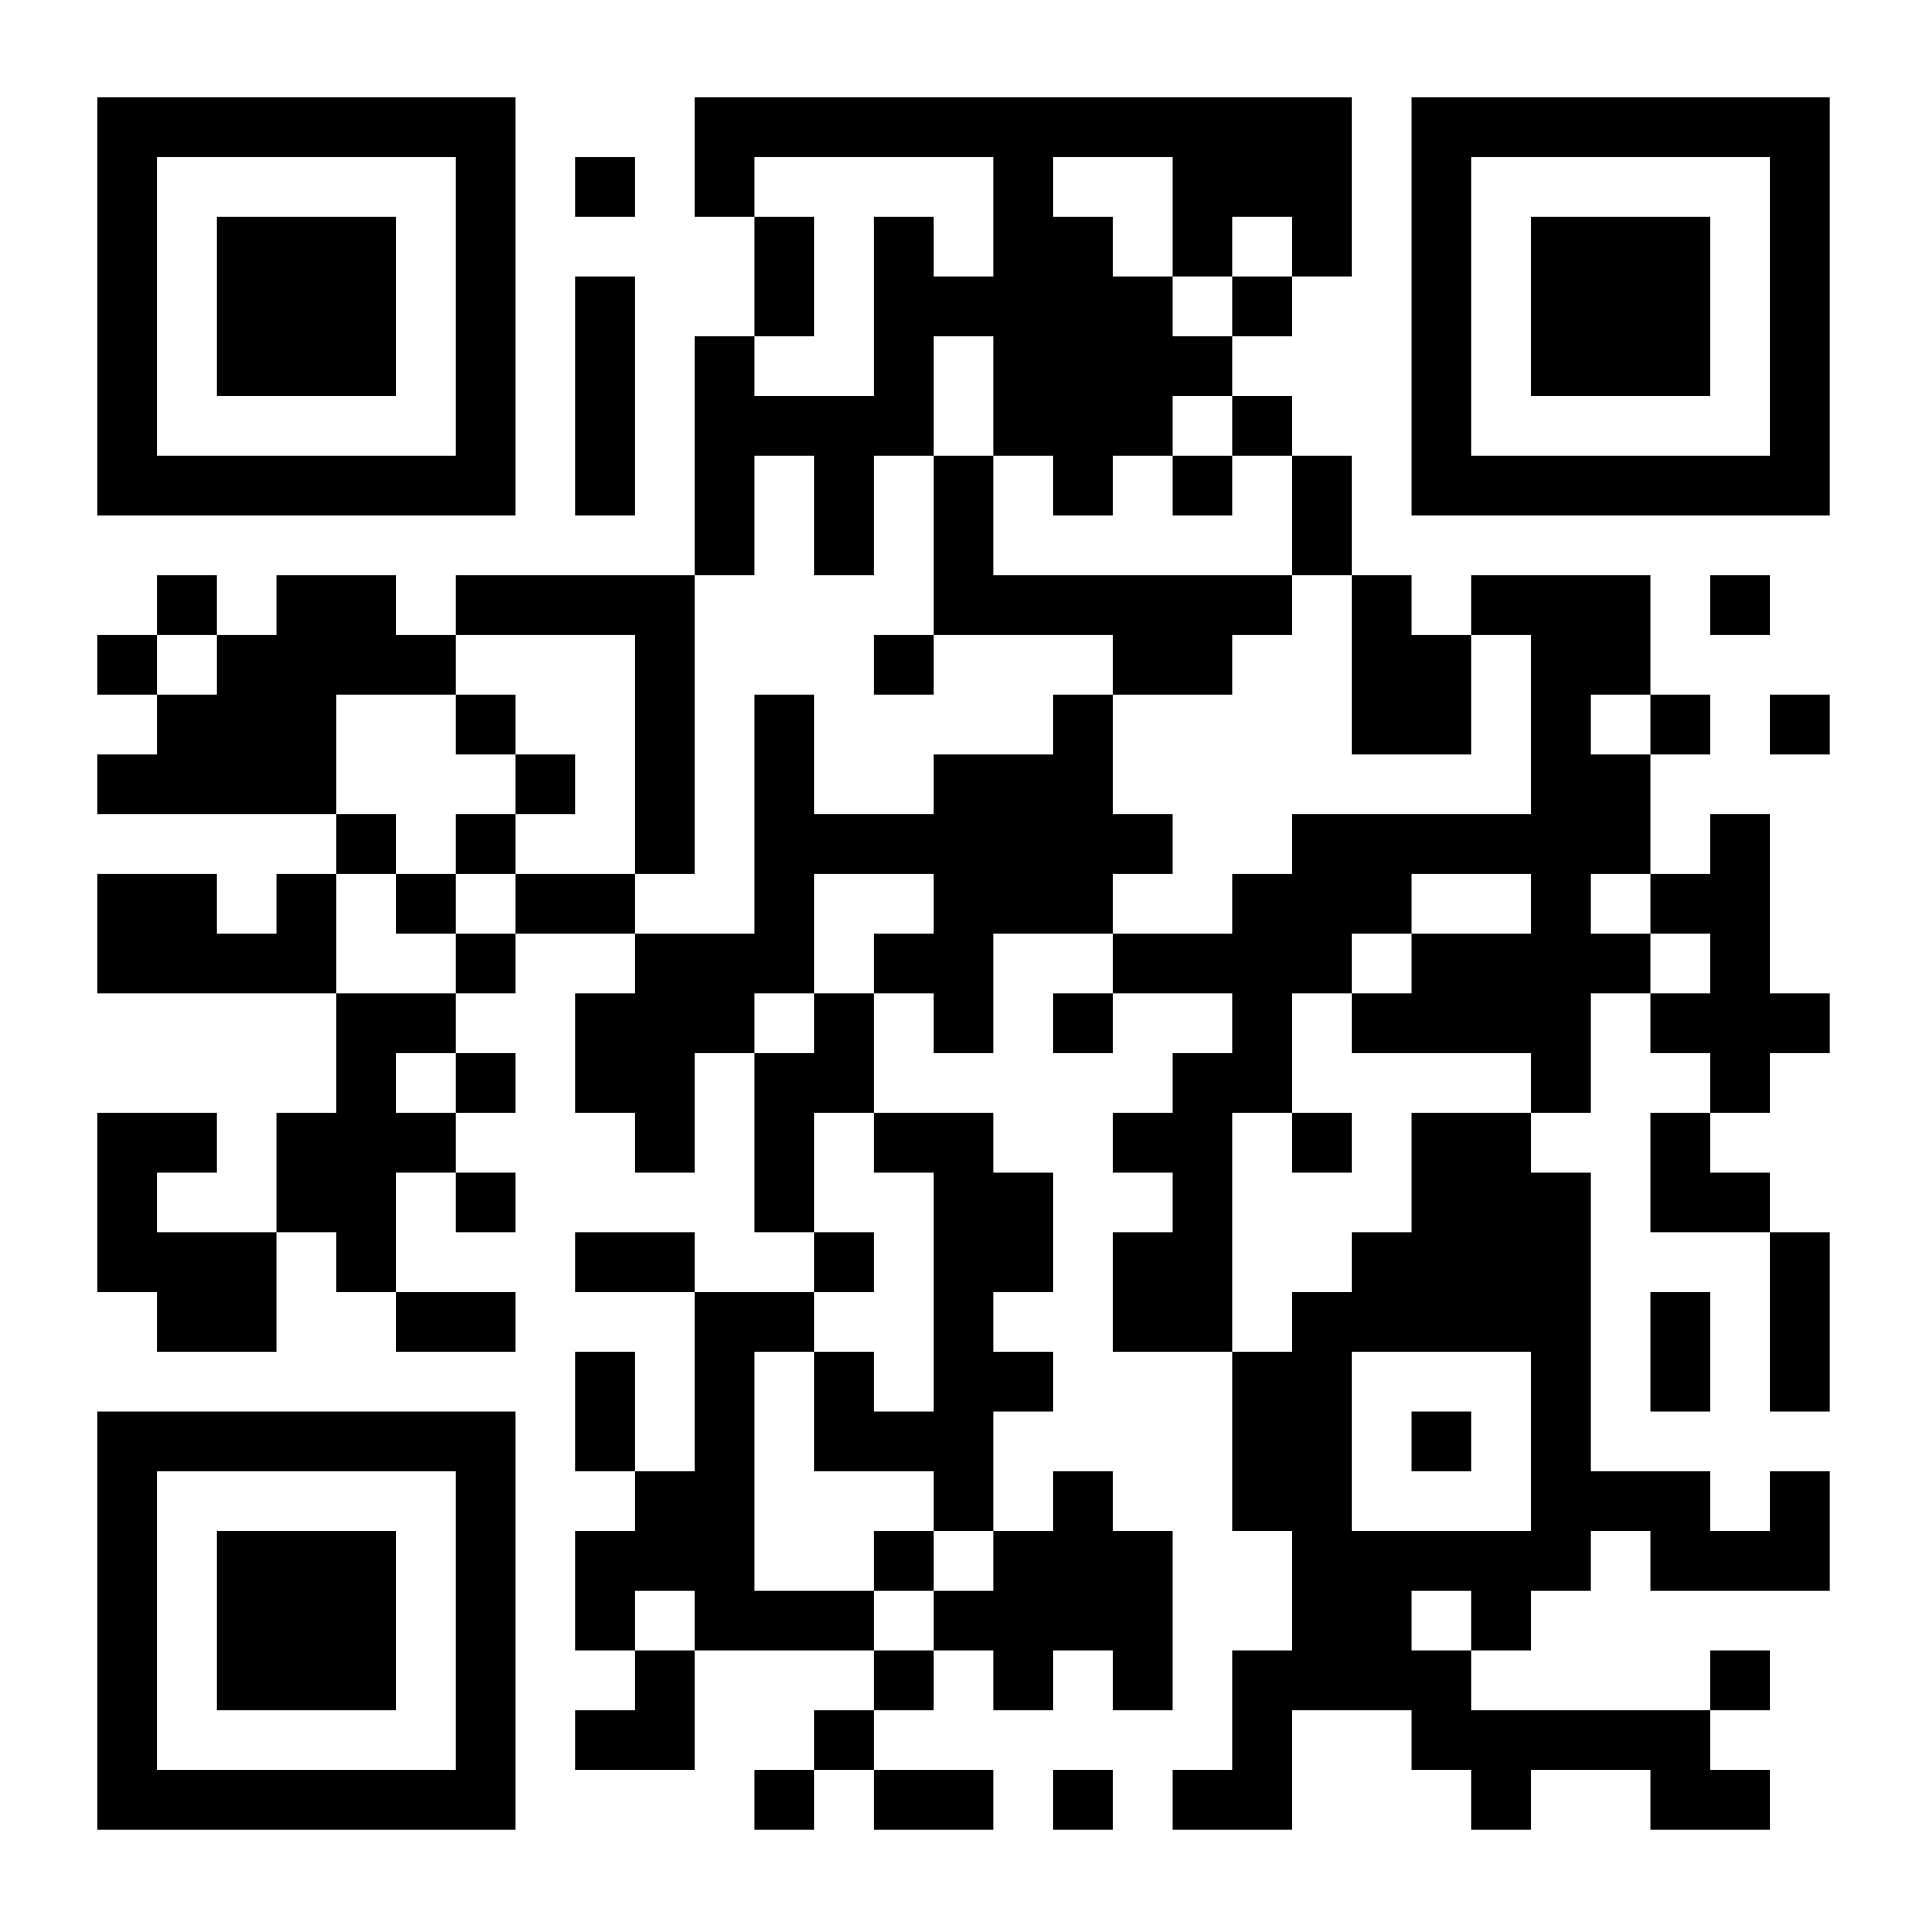
Thank You

